Slide 1

Video Bite
Video Timestamps and Description
Supervised by: Dr. Ashraf AbdelRaouf Supervising Assistant: Eng. Nada Ayman
Ahmed Emad, Mark Refaat, Fady Bassel & Mohamed Abdelhamed

Slide 2
Agenda:
Introduction
Similar Work
Problem Statement
Motivation
System Overview
Expected Result and output
Live Demo
Appendices

Slide 3
Introduction

Slide 4
Introduction:
Millions of videos all over the internet, and more and more are being uploaded every second.
Large collection of videos makes it very hard to find the video you are looking for.
Summarization plays an important role in saving time.
Timestamp helps finding specific part quickly.
Having keywords makes finding process easier
Notes:
Videos topic is very big topic, lots of videos are being uploaded everyday as per youtube statistics 500 hours of videos are uploaded to youtube every minute. And there’s no tool to help

Slide 5
Similar Work

Slide 6
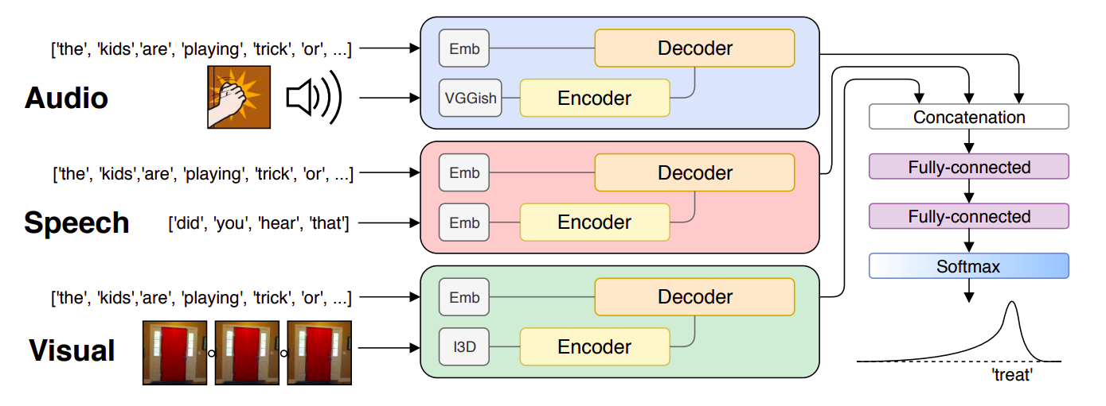
Similar Work (1/3)
Multi-modal Dense Video Captioning - 2020
VGGish for audio feature Extraction, I3D for visual feature extraction and word embeddings for vector representation of text.
Activity Net caption dataset 10K train and 5K validation.
Their result score outperformed all other systems in both ground truth and learned proposals.
V. lashin and E. Rahtu, "Multi-modal Dense Video Captioning," 2020 IEEE/CVF Conference on Computer Vision and Pattern Recognition Workshops (CVPRW), Seattle, WA, USA, 2020, pp. 4117-4126, doi: 10.1109/CVPRW50498.2020.00487.

Slide 7
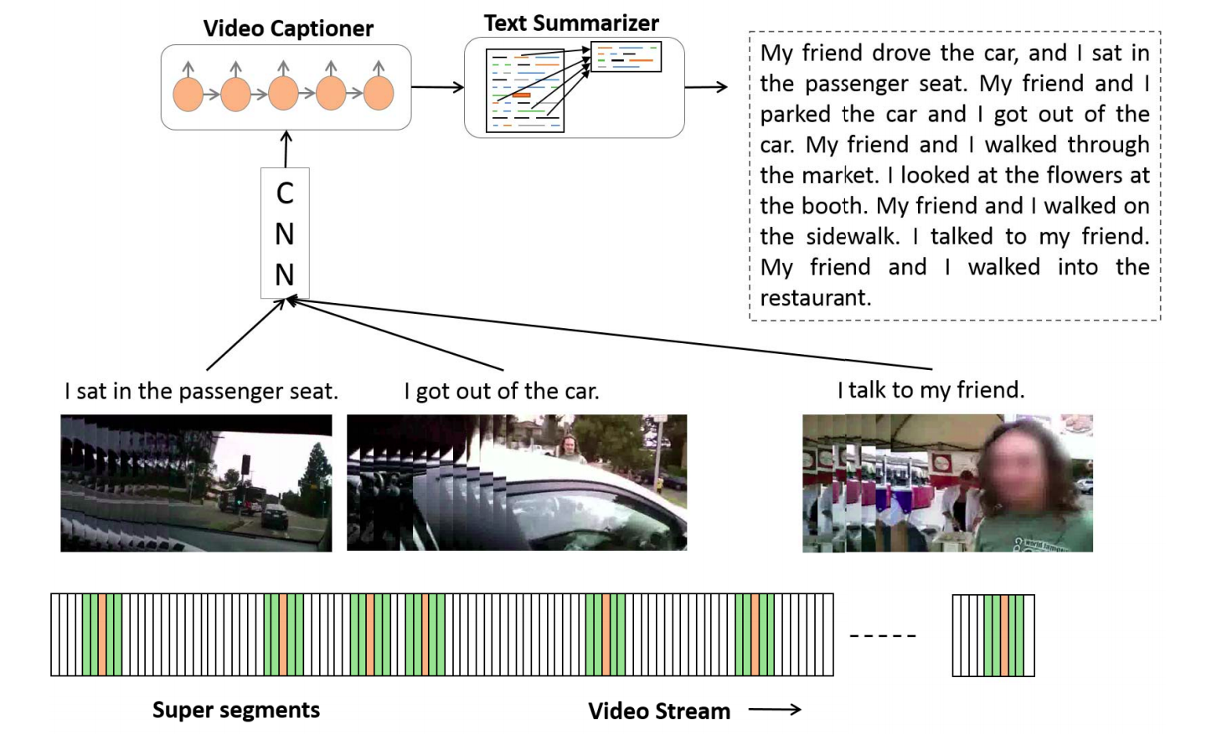
Similar Work (2/3)
Semantic Text Summarization of Long Videos - 2017
Interesting segments according to cinematographic rules “minimum motion”.
Generating Superframe Cut Scores: Boundary Score “B” - Attention Score “A” - Contrast Score “C” - Sharpness Score “E” - Colorfulness Score “S” - Facial Impact Score “F” Fusing Scores Iscore = A · C · E + η(B + F) + γ(S). η = 0.35 and γ = 0.2
Remove duplicate captions and use sumy python framework to summarize all the generated captions to 24 sentences.
Datasets | VideoSet, MSVD
Algorithms | ResNet CNN, LSTM
Output | Summarized Video, Summarized Text
S. Sah, S. Kulhare, A. Gray, S. Venugopalan, E. Prud'Hommeaux and R. Ptucha, "Semantic Text Summarization of Long Videos," 2017 IEEE Winter Conference on Applications of Computer Vision (WACV), Santa Rosa, CA, 2017, pp. 989-997, doi: 10.1109/WACV.2017.115.
Notes:
interesting segments according to cinematographic rules “minimum motion”.
VideoSet eleven long (45 minutes to over 5 hours) videos in three categories: Disney, egocentric, and TV episodes. Eight videos are used for training and three for testing.
captioning model was pre-trained on the training split of the MSVD as the training data form VideoSet is not deemed sufficient.
152-layer ResNet CNN model pre-trained on ImageNet data and LSTM

Slide 8
Similar Work (3/3)
ASoVS: Abstractive Summarization of Video Sequences - 2019
Uses CNN, RNN & LSTM.
“Luong” word-level attention distribution to make abstractive summarization.
MSR-VTT, 2007/8 TRECVID and CNN/Daily Mail datasets.
They build UET Surveillance dataset.
METEOR 29.4 on MSR-VTT, ROUGE-1 40.21 on CNN/Daily Mail.
A. Dilawari and M. U. G. Khan, "ASoVS: Abstractive Summarization of Video Sequences," in IEEE Access, vol. 7, pp. 29253-29263, 2019, doi: 10.1109/ACCESS.2019.2902507.

Slide 9
Problem Statement

Slide 10
Problem Statement:
Content creators find difficulty writing description and adding timestamps for their videos manually. Furthermore, selecting the proper keywords will make it easier for viewers finding their desired videos.

Slide 11
Motivation

Slide 12
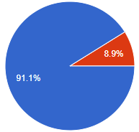
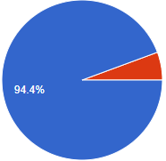
Motivation(1/2):
Would it help you having timestamps for videos for faster search?
91.1% Yes
8.9% No
Solve problems of people who deal with videos frequently
Awareness of most of the problems that face people with videos
Do you think it would benefit the market?
94.4% Yes
5.6% No
Notes:
We were aware of the problems so that we asked people about their opinions, we haven’t expected all these responses we expected to have max 100 response and we closed already the survey when we reached the max target but then we found some people asking to re-open it to express their problems with videos and this a good indication that those problem people really care about. Even that we asked respondents if they have suggestions to make the tool better and we got some and the repeated one was to make the tool bilingual that would definitely help them but that would make the scope so big to finish

Slide 13
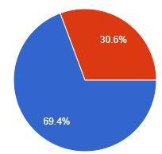
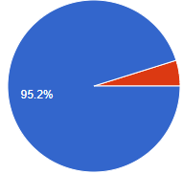
Does video description help you decide whether to watch this video or search for other one?
In your opinion, would this tool enhance the searching results for videos or not?
69.4% Yes
30.6% No
95.2% Yes
4.8% No
Does finding keywords for videos help you for deciding if it’s the right video to watch or not?
Would such a tool help you in your choosing process and facilitate it?
95.2% Yes
4.8% No
95.2% Yes
4.8% No

Slide 14
System Overview

Slide 15

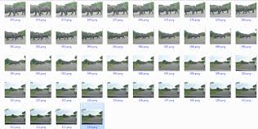


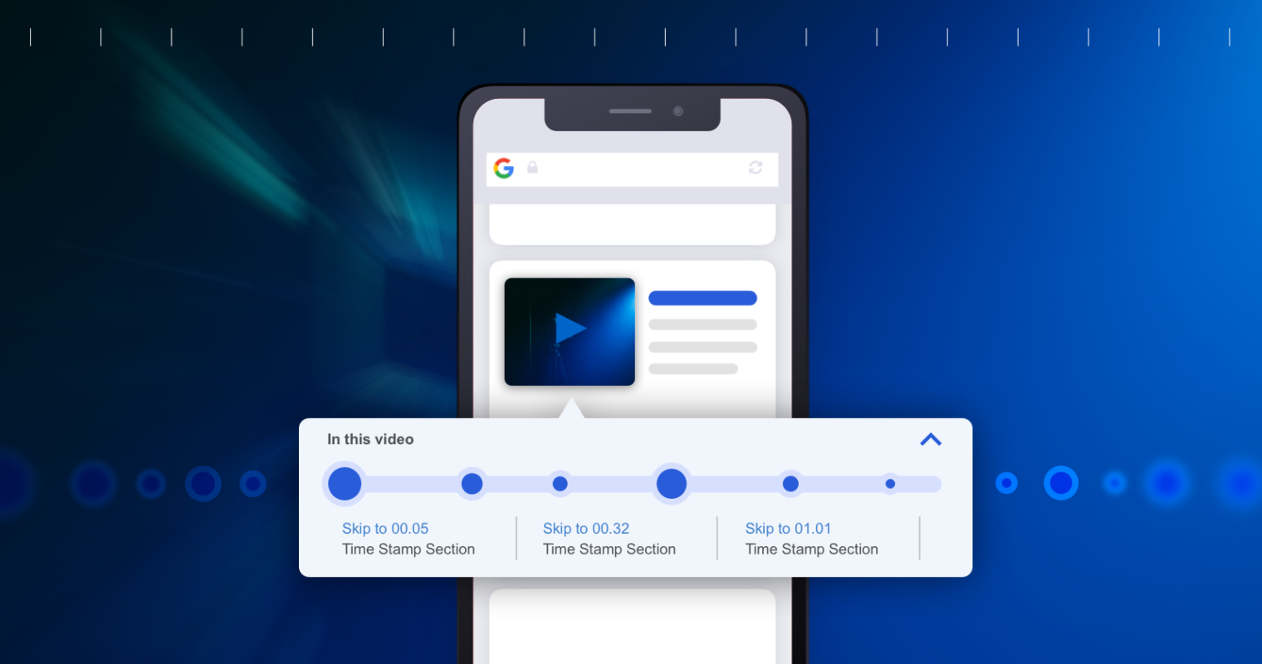

INPUT VIDEO
Pre Processing
(Scene Splitting)
Frames
Pre Processing
(Remove unclear frames)
Speech
Pre Processing
(Speech to text)
….
….
Emotions
LSTM
Model
NLP Model
(sentence merging)
Timestamp
Fusion
Summary
Frame description Emotion description
Audio transcription

Slide 16
Fusion:
Output from video
Output from audio
Output from emotions
- Linking Words (ex. But, and, where, etc.)
- Remove duplicate words.
- Remove duplicate names and replace it with he, she or it.
Final Summarized Text

Slide 17


Fusion Example:
“Someone holding phone”
By fusion of the two modalities
“The battery is 4000mah”
He says that the phone battery is 4000mah

Slide 18
Expected Result & Output

Slide 19
Expected Result & Output:
Generated text from video,emotions and audio.
Fusion between all generated texts and summarize to get meaningful description for videos.
Timestamps generated for videos.
Extract the video’s keywords.

Slide 20
Live Demo

Slide 21
Any Questions ?
THANK YOU!

Slide 22
Appendices
We got some suggestions to improve the tool:
Convert the video into text to make it easier if I am looking for something specific
To be tested couple of times with voice recognition to avoid writing invalid or wrong words
Not based on keywords as it will have unlimited answers
Bilingual key words
Bilingual
Customize an option to choose the best tags that can be linked to the video based on its activity on any platform
No the idea is really good it synchronize the image with the voice processing really good

Slide 23
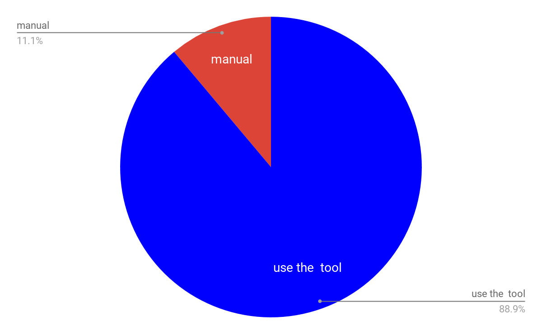
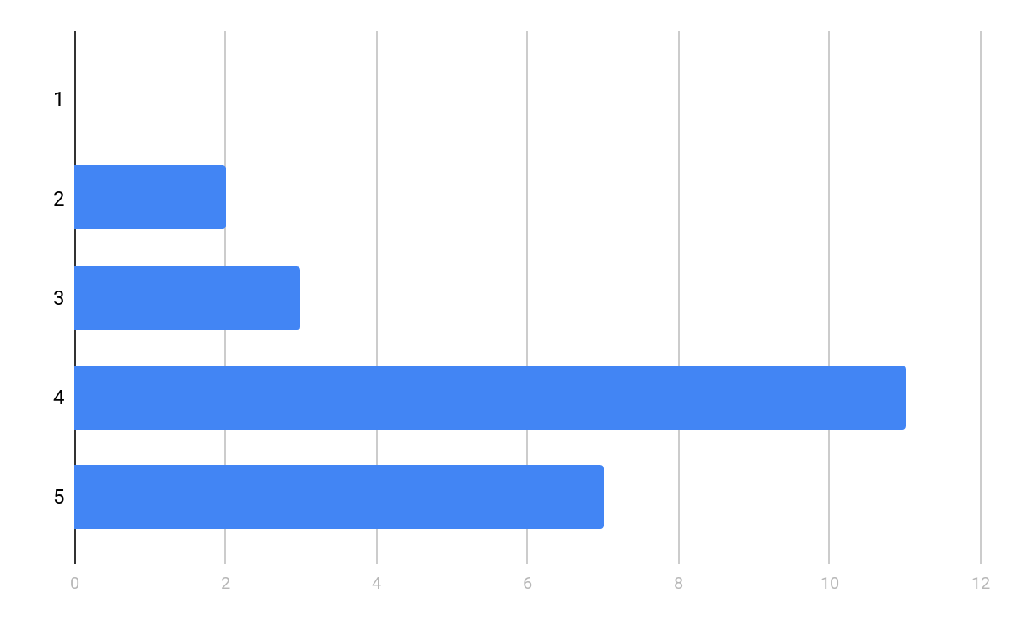
Survey (1/2):
Do you prefer to use such an application or depend on manual description for your videos?
88.9% use the tool
11.1% Manual
As per survey, respondents said that the average time for writing the descriptions of their videos is 5 mins.
Average words are 100-200 words.
If such a tool is given to you,would it make the process easier?
0% Strongly disagree
7.4% Disagree
11.1% Neutral
40.7% Agree
25.9% Strongly agree

Slide 24
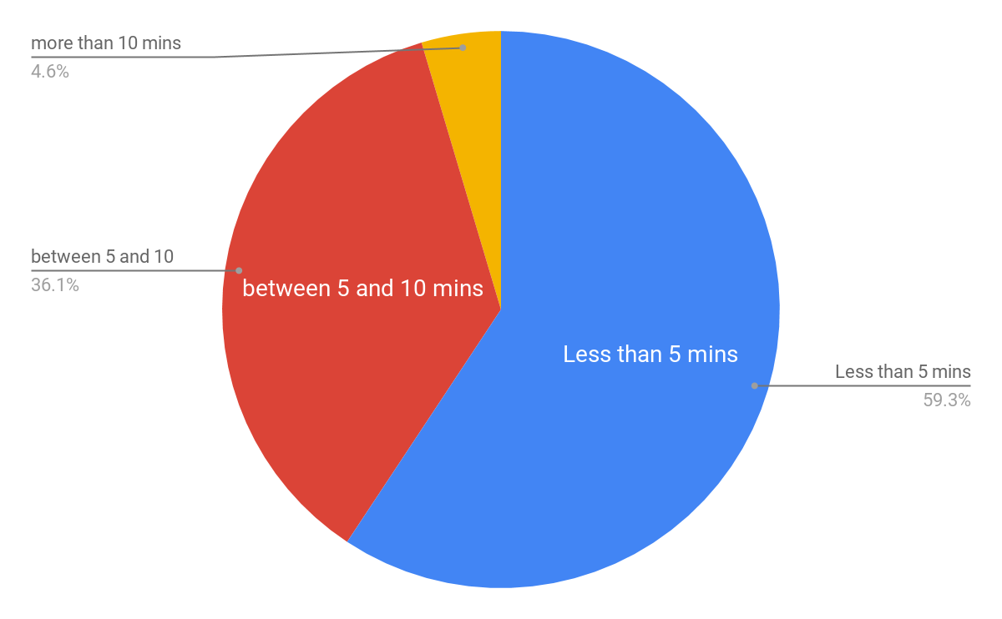
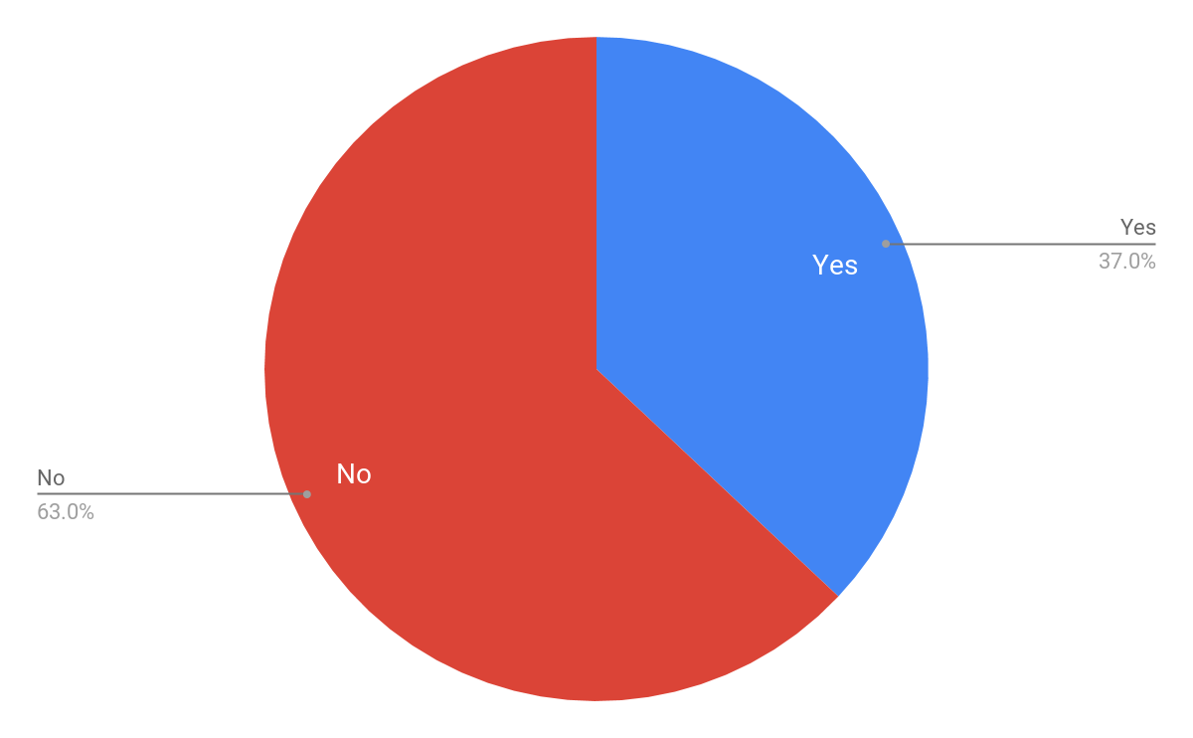
Survey (2/2):
How much time do you take to search for a desired video?
As per the survey, no one know any summarization tool for videos based on both video and audio.
Most of our respondents don’t create or upload videos, but half of whom create don’t write description for video.
88.9% Less than 5 mins
11.1% between 5 and 10 mins
4.6% more than 10 mins
Do you always find that video title and description match video content?
37% Yes
63% No

Slide 25
.
.
.
.
Frames
Pre Processing
(Remove unclear frames)
Input
Pre Processing
(Split video to small videos based on scene)
Speech
Emotions
LSTM
Model
.
.
.
.
Pre Processing
(Speech to text)
Summary
Fusion
Frame description Emotion description
Audio transcription
NLP Model
Timestamp

Slide 26
Frames
Pre Processing
(Remove unclear frames)
LSTM
Model
Emotions
.
.
.
.
Input
Pre Processing
(Scene Splitting)
.
.
.
.
Speech
Pre Processing
(Speech to text)
Summary
Fusion
Frame description Emotion description
Audio transcription
NLP Model
Timestamp

Slide 27
INPUT VIDEO
Frames
Pre Processing
(Remove unclear frames)
Pre Processing
(Scene Splitting)
Speech
Pre Processing
(Speech to text)
….
….
LSTM
Model
Emotions
CNN
Model
NLP Model
(sentence merging)
Timestamp
Fusion
Summary
Frame description Emotion description
Audio transcription

